Slide 1

Pune Institute of Computer Technology, Pune
Department of Electronics and Telecommunication Engineering
Topic: LCD Interfacing
Subject: Microcontroller
By : Mr. Deepak M. Shinde
Assistant Professor

Slide 2
Session contents
Basics of LCD
Structures of LCD
Commands for LCD
LCD Interfacing with 8051
Algorithm to Interface LCD

Slide 3
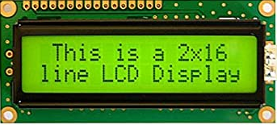
Basics of LCD
16×2 LCD
Line 1
80H | 81H | 82H | 83H
C0H | C1H | C2H | C3H
Line 2
Notes:
In 16×2 LCD, have two rows or lines, In Each row we can display 16 character
The address of the first character of line1/ row1 or is start at 80H,next one is 81H and so on
The address of the first character of line 2/row2 is start at c0H,next one is c1H and so on
For e.g. I want to display PICT on first row & starting to display from character address 81H,so at 81H address character P is display ,and 82h address character I is display and so on

Slide 4
Structures of LCD
Command Register
Data Register
D0-D7
RS
R / W
E
Notes:
LCD have two internal register ,The first register is command register and second register is data register
LCD have three control signal RS-Register select,R/W bar and E Enable
In command register, user can stored the command such as clear the display, display on cursor blinking etc.
In Data register, user has stored the ASCII value of the character we want to display
The selection of command reg.or data register depends on status of RS control signal
If RS is zero ,The command register is selected;If RS is one,The Data register is selected.
So whenever we want to write command or data ,first we have to select an appropriate register.
The second control signal of LCD that is R/W bar;When it is zero ,we can write the data on the LCD module
When it is one , we can read the data from LCD module
The third control signal is latch enable;Whenever we want to latch a data i.e. first we will place data or command on data bus d0-d7 ;
after that we we have to send enable signal.The enable signal for the write operation is high to low pulse ;
so we have to make this terminal high for some delay or immediately we can send logic zero pulse on this enable signal

Slide 5
Commands for LCD
Command to LCD | Code (Hex)
To Select LCD of 16 ×2 lines and 5x7 matrix | 38
Display on cursor blinking | 0E
Clear the display | 01
The address of first character of line 1 | 80
The address of first character of line 2 | C0
Notes:
The no.of commands are available for LCD,but generally we used four commands
First command is 38H which is used to select LCD of 16×2,5×7 matrix display,i.e. to display each character on LCd dot matrix pattern 5×7 is used
Second command 0EH which is used to display on,cursor blinking
Third command is 01H which is used to clear the display;before displaying any data on LCD we can sent this command to clear the previous data on LCD
Important command to the LCD is relating to the addressing of the character ;In 16×2 LCD,in each line there are 16 character .
The address of the first character is 80H
The address of the first character is C0H

Slide 6
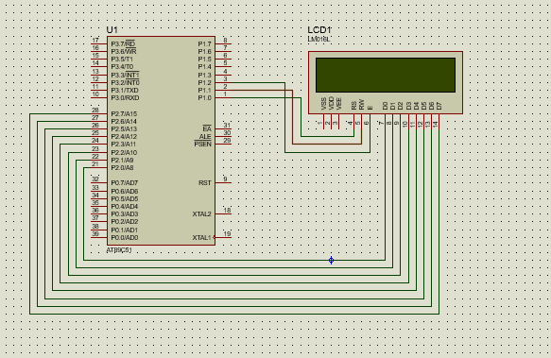
LCD Interfacing with 8051

Slide 7
Algorithm to Interface LCD with 8051
Initialize P2 and P1 where D0 –D7 and control lines(R, RW, E) are interfaced respectively
Initialize LCD by sending appropriate commands (38h,0Eh,01h,80h)
While sending commands; the control signals should be Rs=0,RW=0,E= H-L
Load the data to be displayed on the data bus D0 to D7 and give appropriate control signals (Rs=1,RW=0,E= H-L)
Give suitable delay wherever necessary
Loop in order to send character or string

Slide 8
References
Muhammad Mazidi- The 8051 Microcontroller and Embedded Systems, Pearson Education 2nd Edition.
Notes:
There are several references as books and website you may choose on of the above and any other for improving domain knowledge.

Slide 9
Questions if any!
Thanks
Please write for queries, suggestions and feedback : dmshinde@pict.edu

